Slide 1
Intonational Phonology of Miami Cuban Spanish
Ann Aly bailey
University of California, los angeles
aabailey@ucla.edu

Slide 2
Objectives
Create a Tone and Break Indices (ToBI) system within the Autosegmental-Metrical (AM) model for Miami Cuban (MC) Spanish
Allow for comparison between other languages and Spanish varieties using the same approach
Provide evidence for
Changes in boundary tone variation for questions in MC Spanish (compared to previous studies)
Distinctions between discourse categories based on pitch scaling and pitch timing

Slide 3
Previous work on Cuban Spanish Intonation
Alvord (2010): Intonation of yes/no questions in Miami Cuban Spanish
Use of low of high boundary tones in questions was indexed by immigrant generation (Vuelos de Libertad, Marielitos, Miami-Born)
García Riverón (2010): Intonation of yes/no questions and declaratives in Havana dialect
Uses AMH (Análisis Melódico del Habla, “Melodic Analysis of Speech” framework)
Muñoz Alvarado (2012): Santiago de Cuba dialect intonation of neutral questions and declaratives in Santiago de Cuba dialect
Also in AMH framework
Dorta (2013): Comparative study of intonation in Canarian, Cuban, and Venezuelan speech
AM framework; controlled speech (SVO declaratives and yes/no questions)
What’s still needed:
More complete analysis/model of Cuban intonation
ToBI of US Spanish dialects

Slide 4
The present study: Methodology
Consultants (n = 9)
5 Cuban-Born speakers (3 F, 2 M); 39-68 years old
1 person who immigrated in the Vuelos de Libertad generation; 2 Marielitos; 2 Balseros
4 Miami-Born speakers (3 F, 1 M); 24-36 years old
College-educated graduate students or professionals
Elicitation
Reading task
Declaratives, questions, commands, focus elicited in controlled utterances
Number of content words and location of stressed syllables controlled (following Jun & Fletcher 2014)
Discourse Completion Task (DCT)
Modified for Cuban Spanish from Roseano & Prieto (2010)
Elicits numerous sentence types while allowing for semi-spontaneous answers

Slide 5
Examples from data collection: Reading task
Declaratives:
(S= stressed syllable; s= non-stressed syllable)
(Sss sSs sSs) Médicos veían ovejas. (Doctors saw sheep)
(sSs sSs sSs) Lorena veía limones. (Lorena saw lemons/limes)
Questions (wh, yes/no, tag, requests):
Used similar lexical items as declaratives
¿Marina/Quién bebe limonada? (Marina/who drinks lemonade?)
Imperatives:
Similar lexical items as other categories
¡Bebe limonada! (Drink lemonade!)
Focus:
Short pseudo-dialogue with focused word(s) in caps
(¿Quién bebe limonada?) MARINA bebe limonada.
[(Who drinks lemonade?) MARINA drinks lemonade]

Slide 6
Examples from data collection: DCT
Declaratives:
Mira el dibujo y di lo que hace la mujer. (Look at the photo and say what the woman is doing)
Vocatives:
Entras en la casa de una amiga, Marina, pero no la ves. Llámala. (You enter your friend Marina’s house but you don’t see her. Call out to her)
Questions:
Neutral: Estás en la calle y quieres preguntar la hora. (You are on the street and you want to ask the time)
Biased: Te dicen que un compañero tuyo, Mario, se apostula para alcalde. No lo crees y lo vuelves a preguntar. (They tell you that your friend, Mario, is running for mayor. You don’t believe it and you ask again)

Slide 7
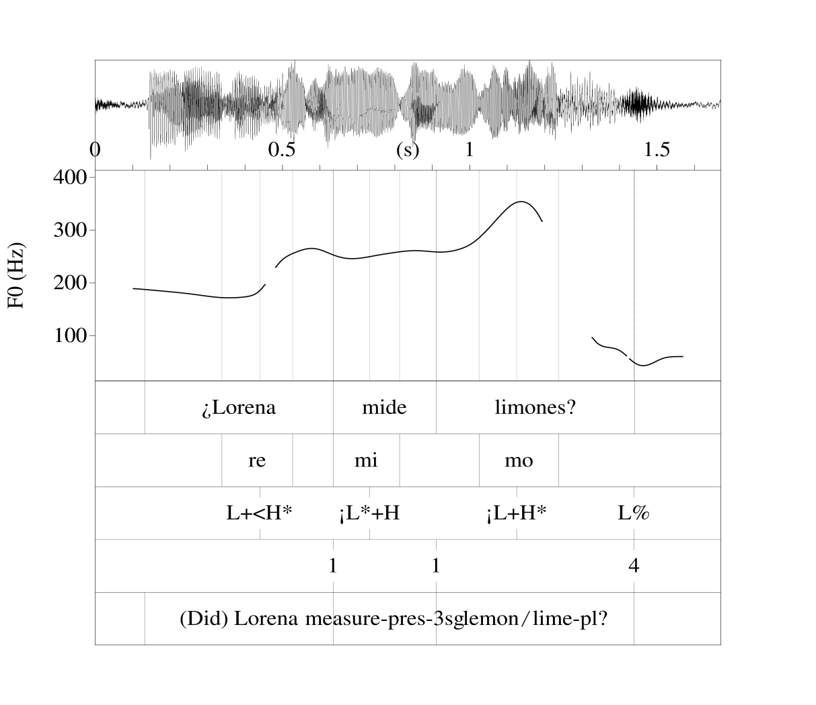
Data analysis
All data analyzed in Praat, version 5.3.73 (Boersma & Weenink 2014)
Total tokens analyzed:
Reading task: n = 220
DCT: n = 501
Tones, breaks, miscellaneous information, and orthographic transcriptions recorded on point and interval tiers in Praat following ToBI conventions
Waveform
Pitch track
Word tier
Syllable tier
Tone tier
Breaks tier
Gloss tier

Slide 8
Tonal inventory of MC Spanish: Prenuclear pitch accents
1 underlying prenuclear pitch accent: L+H*
3 allotones
L*+H: 65% of total data*
L+<H*: 21%
More common in careful speech; reading
L+H*: 14%
Typically used on words with final stress
Upstepped/downstepped variants also possible (L+!H*, L+¡H*, ¡L+H*, etc)
Timed (L+H*) and delayed (L+<H*) peaks:
Although not distinctive, showed a significant difference in peak timing from syllable edge, t(99)= 2.8, p = .006
*n = 791 total pitch accents

Slide 9
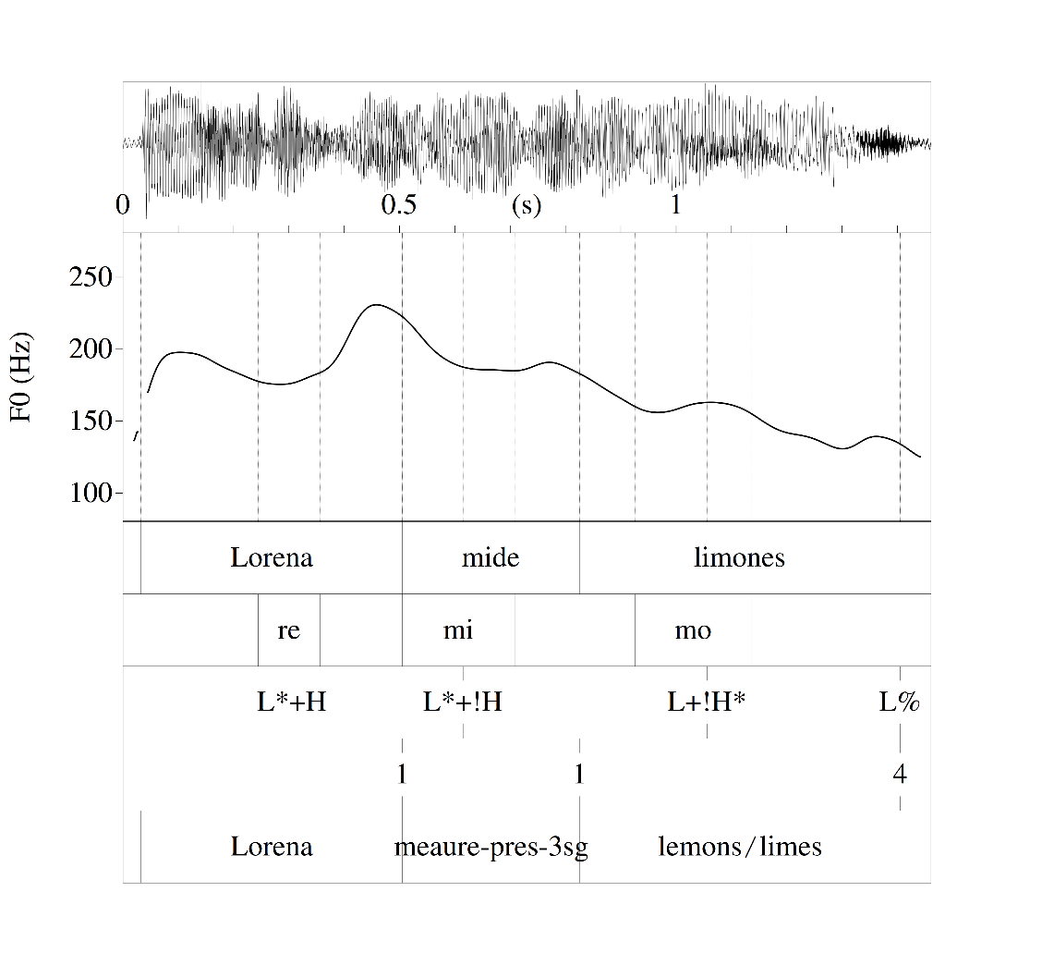
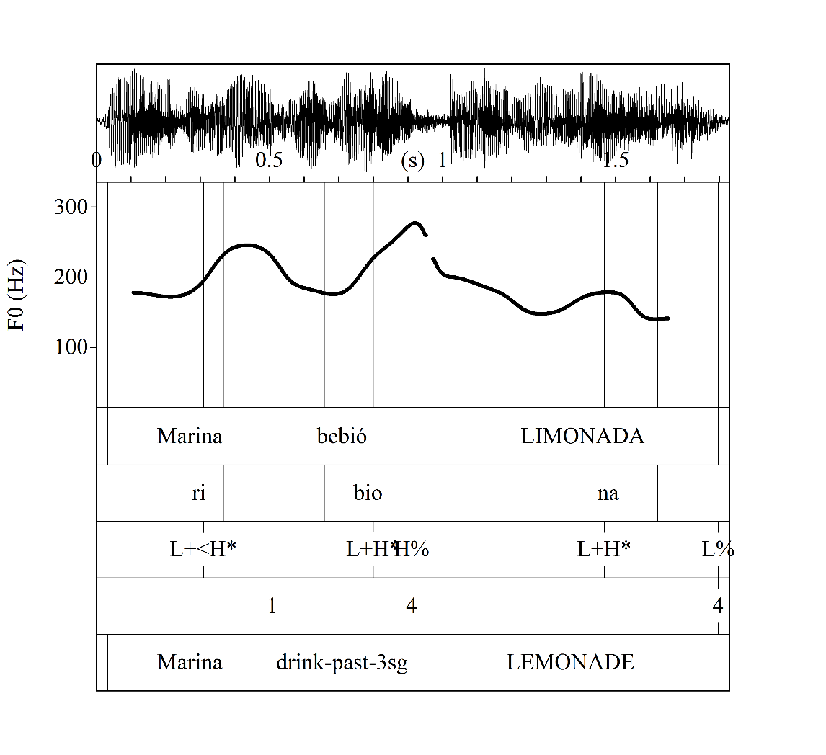
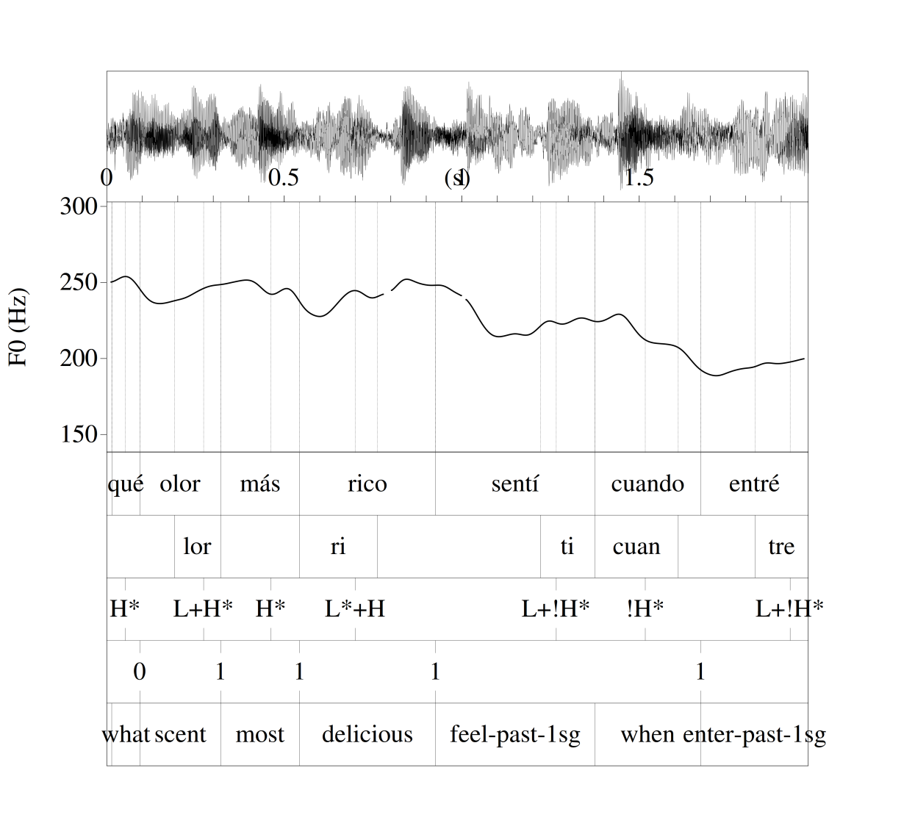
Prenuclear pitch accents: Examples

Slide 10
Tonal inventory of MC Spanish: Nuclear pitch accents
Monotonal
L*: Found in question types ending in H%
May also be realized with upstep
Bitonal
H+L*: Found in broad focus declaratives
L+H*: Found in broad focus declaratives (Cuban-born only), exclamatives, vocatives, imperative, various question types
Most common nuclear pitch accent
Peak timing and scaling as important factors to distinguish between categories (to be discussed)

Slide 11
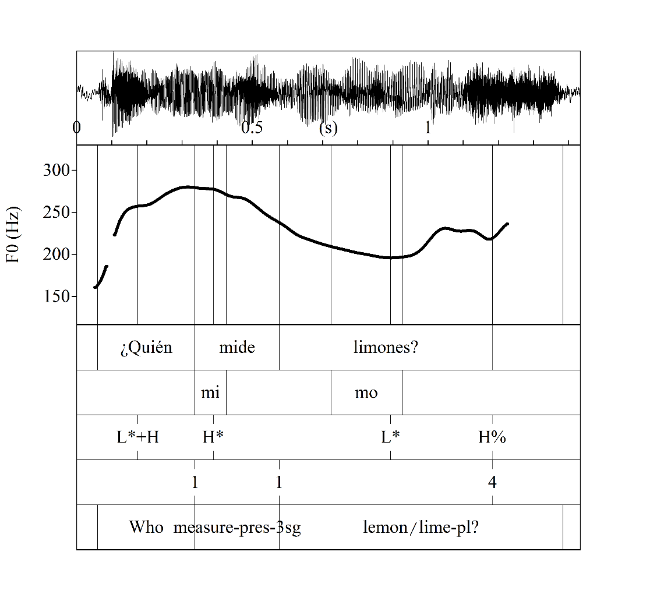
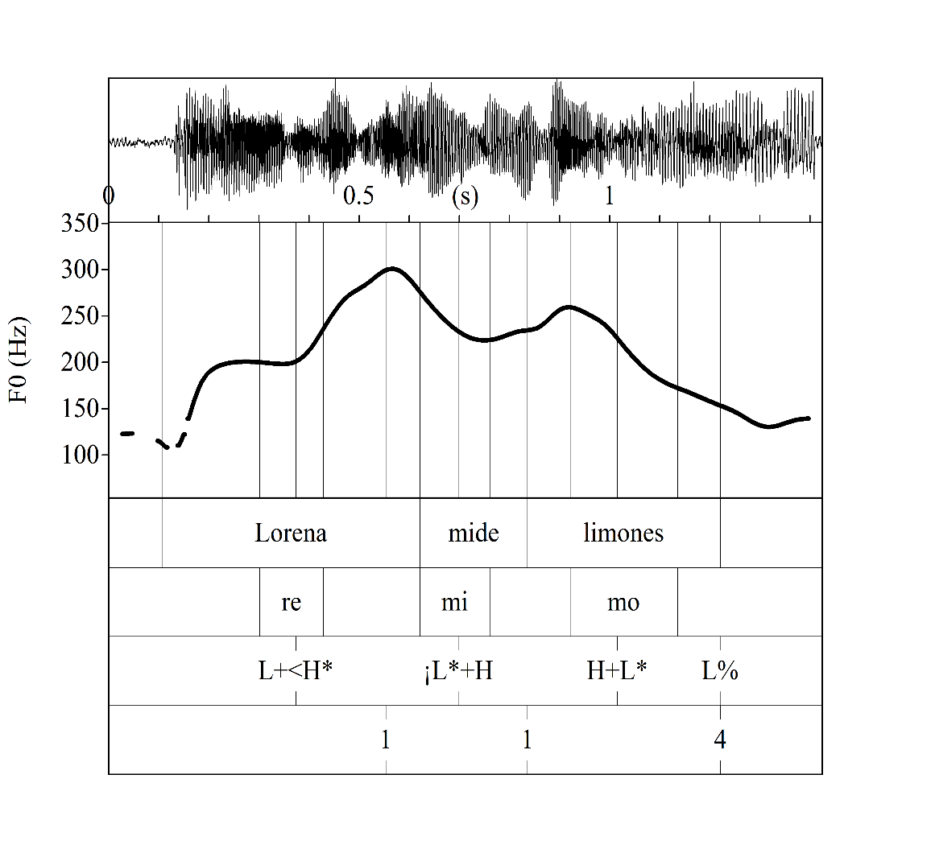
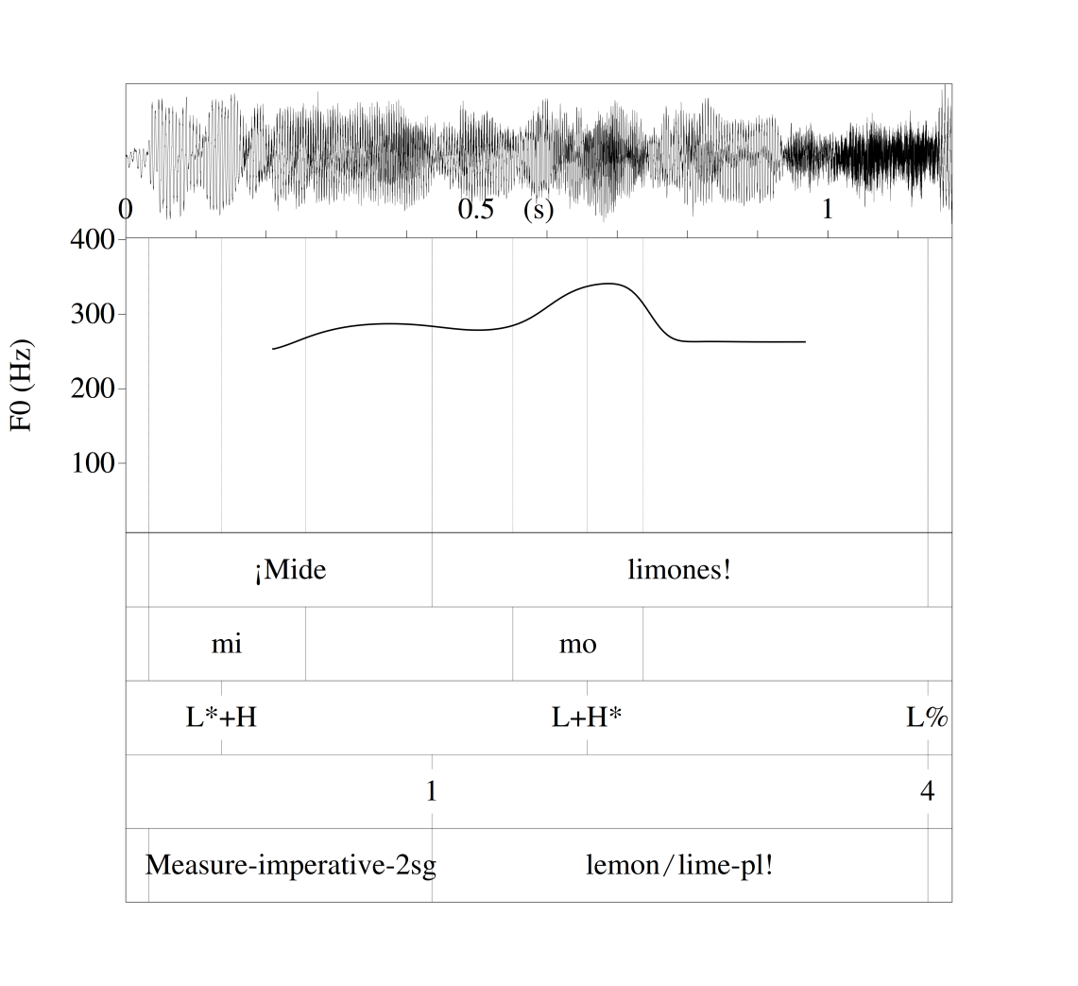
Nuclear pitch accents: Examples

Slide 12
Tonal inventory of MC Spanish: Boundary tones
Low
L%: Used in various statement types (declarative, insistent vocative, exclamative, yes/no questions, binary questions)
L-: Used as a connector between clauses of larger utterances; indicative of a syntactic dependency
High
H%: Used as a variant in most question types and requests
H-: Seen in lists and to hold the floor in longer speech samples
Mid
M% (falling f0 only*): Used in vocatives and confirmation/biased questions
M-: Least common ip boundary tone; seen in within-IP vocatives, hesitations
* Slightly rising f0 boundary tones are interpreted as H%

Slide 13
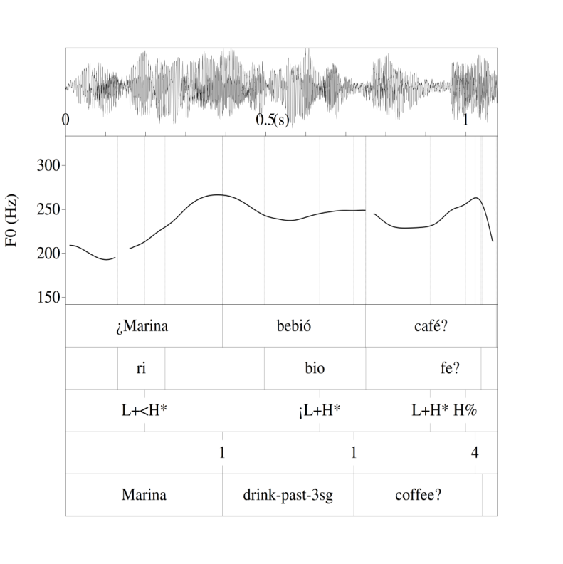
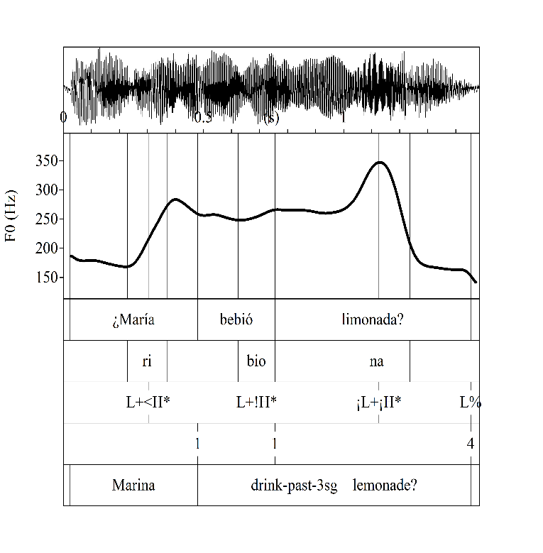
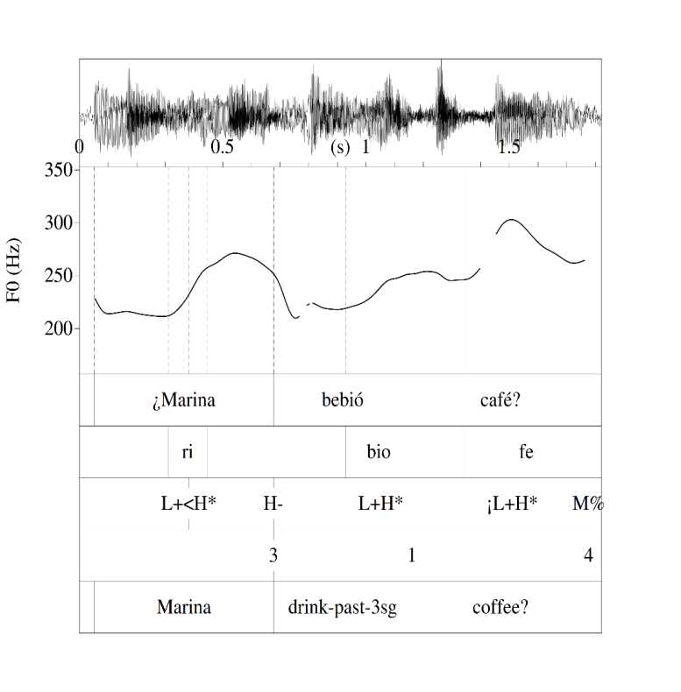
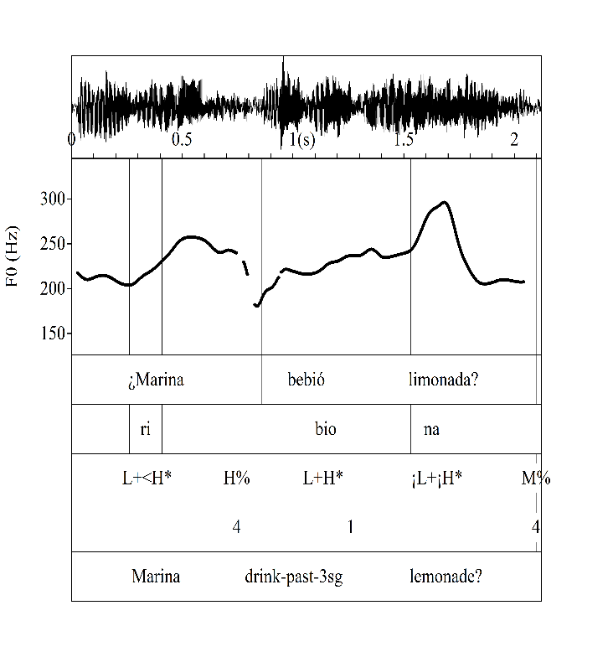
Boundary tones: Examples
Neutral question
Neutral question
Biased question
Biased question

Slide 14
Nuclear configurations of Caribbean Spanish dialects*
Type | Puerto Rican | Miami Cuban | Dominican
Pre-nuclear pitch accent | L*+H
Imperatives | L* HL% | L+H* L% | H+L* L%
Broad Focus | H+L* L% |  | H+L* H%
 | L+H* L% |  | L+H* H%
Narrow Focus | H* L% | L+H* L% | L+H* LH%
 | L+H* L% |  | H+L* L%
Vocative | L+H* M% |  | L+H* LH%
Insistent Vocative | L+H* HL% | L+H* L%
Echo Question | L+(¡)H* L% |  | H+L* L%
 |  | L+H*/L* H%
Wh-Question | H+L* L% | L+H* L% | H+L* H%
 |  | L+H*/L* H% | L* H%
Exclamative |  | L* M% | L+H* LH%
 | L+H* L%
Request | L * M% | L+H*/L* H% | ¡L+H* M%
 |  |  | H+L* L%
Yes/No Questions |  | L* H% | H+L* H%
 | L+(¡)H* L% |  | H+L* L%
Tag question | L* H%
 | L+H* H%
Confirmation question | H+L* L% | L+H* M% | H+L* L%
 |  |  | H+L* H%
*Willis (2010) for DR Spanish; Armstrong (2010) for PR

Slide 15
Further considerations: Pitch peaks
Peak timing of nuclear pitch accents
Peak height of nuclear pitch accents
Time (ms) from pitch peak to end of syllable edge was significantly different between questions and statements
Question peaks are later than non-question peaks, t(19)= 2.5, p = .01
f0 of nuclear pitch accent and preceding peak measured for questions and declaratives of two speakers (one male, one female)
Speaker | Question | Declarative
1 (male) | 19% increase | 16% decrease
2 (female) | 44% increase | 22% decrease
Nuclear pitch accent and boundary tone of question and declarative statements

Slide 16
Further considerations: Question boundary tones
As reported in Alvord (2010), yes/no questions can end in L% or H% in MC Spanish
Biggest predictor of boundary tone use: immigrant generation
Vuelos de Libertad speakers and Miami-Born speakers preferred L%; Marieltios preferred H%
In the current data, yes/no questions as well as requests and wh-questions can end in L% or H%
No speakers categorically preferred L% or H% across all 3 sentence types
Within a sentence type, speakers (of all generations) tended to prefer H%
The speakers who favored L% were Marielitos (and 1 Miami-Born speaker whose parents are Marielitos)
Categorical boundary tone preference by speaker
Type | H% boundary tones Speaker (generation) | L% boundary tones Speaker (generation)
Requests | 2M (balsero); 5F (vuelo) | ---
Wh-questions | 1M, 3F (MB); 2M (balsero) | 3M (marielito)
Yes/no questions | 3F (MB); 5F (vuelo); 3M (marielito) | 4M (marielito); 1F (MB)

Slide 17
Summary of results
MC ToBI
One prenuclear pitch accent (L*+H); three allotones (L*+H, L+H*, L+<H*)
Three nuclear pitch accents (L+H*, H+L*, L*)
Three boundary tones (H, L, M)
Nuclear configurations most similar to Puerto Rican Spanish
Peak timing and height
Peak timing: Nuclear pitch accent peaks timed later in questions (than non-questions)
Peak height: In small sample of two speakers, pitch peaks higher for questions
Boundary tone variation
H% and L% are used for yes/no questions, wh-questions, and requests
Most speakers prefer H% when categorical; L% favored by Marielitos than other groups

Slide 18
Discussion and further directions
Peak timing and height:
In order to test how crucial these peak differences are, perceptual data is needed
In progress: Peak height and timing manipulations for interpretation tasks
Interactions of peak height and timing also considered
Boundary tone variation: A shift in social indexing or a change in dialectal preference?
Current results differ from preferences reported in Alvord (2010)
Possible reasons for this shift
Presence of non-Caribbean Spanish-speaking communities in South Florida; dialectal leveling
L% may no longer be associated with Vuelos or high SES groups
Further work on social attitudes, interactions of Spanish-speaking groups in South Florida, and a more diverse/larger sample of Cuban-(American) speakers needed

Slide 19
Acknowledgments
Cuban and Cuban-American consultants
Sun-Ah Jun, advisor
UCLA Phonetics Lab members for their feedback and support
Franny Brogan and Mariska Bolyanatz from the UCLA Spanish & Portuguese
UCLA Graduate Summer Research Membership for financial support to collect data

Slide 20
Thank you!/¡Gracias!
Questions? / ¿Preguntas?

Slide 21
References
Alvord, S. M. (2010). Variation in Miami Cuban Spanish interrogative intonation. Hispania, 93(2), 235-255
Armstrong, M. (2010). Puerto Rican Spanish intonation. In P. Prieto and P. Roseano [Eds],Transcription of Intonation of the Spanish Language, 155-189, Lincom: Europa München.
Boersma, P. & D. Weenink, D. (2014), Praat: Doing phonetics by computer [computer program], version 5.3.73, retrieved from www.praat.org.
Dorta, J. (Ed.) (2013), Estudio comparativo preliminar de la entonación de Canarias, Cuba y Venezuela, Madrid- Santa Cruz de Tenerife: La Página ediciones S/L, Colección Universidad.
García Riverón, R. et al. (2010) El sistema de entonación del español de Cuba a la luz del modelo de análisis melódico del habla", Phonica: 3-25.
Muñoz Alvarado, A. (2012), La entonación neutral en el habla de Santiago de Cuba. Santiago(130): 62-76.
Willis, E. (2010), Dominican Spanish Intonation. In P. Prieto and P. Roseano [Eds], Transcription of Intonation of the Spanish Language, 125-153, Lincom Europa: München.

