Slide 1
INFORMATIONAL FOCUS IN ASTURIAN SPANISH: PROSODY AND SYNTAX
Covadonga Sánchez Alvarado
University of Massachusetts, Amherst
1st Symposium on Intonation & Tone in the Spanish-Speaking World
University of Massachusetts, Amherst
October 10-11

Slide 2
INTRODUCTION
Analysis of the intonational strategies (pitch accents and boundary tones, if present) that are associated with different syntactic structures used in the expression of informational or neutral focus.
Dialect never considered before: Asturian Spanish
Different elicitation task

Slide 3
BACKGROUND

Slide 4
THE EXPRESSION OF FOCUS
Typology (Vallduví, 1993; Vallduví and Engdahl, 1996):
Plastic languages (English, Dutch):
The prosodic pattern is "moulded" to fit the information structure, so that intonation is used to mark information status.
Non-plastic languages (Italian, Catalan, French, Spanish):
Constrained intonation structure to mark information status;
They rely more heavily on word order variation
Face and D’Imperio (2005): proposal of a new typology: A continuum of word order and intonation in marking contrastive focus.

Slide 5
SPANISH: TWO CONFLICTING VIEWS (Gabriel, 2006, 2010)
Derivational studies (Samek-Lodovici, 2003; Zubizarreta, 1998; Gutiérrez-Bravo, 2002):
New information, that is, the focus of a given utterance, comes in final position, where it receives prosodic prominence in Spanish
Neutrally focused initial subjects are ungrammatical
SVO word orders with prominence on the subject can only have a contrastive reading
Intonational studies (Gabriel 2006, 2010; Muntendam, 2009; Hoot, 2012; Vanrell and Fernández-Soriano 2013 inter alia):
Focus marking in-situ is perfectly acceptable with a neutral focus reading

Slide 6
DERIVATIONAL ANALYSES
Zubizarreta (1998):
The Nuclear Stress Rule (NSR): Assign nuclear stress to the rightmost lexical category in a Sentence.
Nuclear stress is Spanish is assigned sentence-finally
FPR (Focus/Prominence Rule): The focused constituent is the most prominent one.
P-movement (movement of non-focused constituents) takes place In Spanish when the NSR and the FPR assign prominence to different constituents:
* [_{F}El niño] rompió el vaso
Rompió el vaso [_{F}el niño]

Slide 7
INTONATIONAL STUDIES
Gabriel (2010):
Semi-spontaneous data from an elicited production task (short stories and questions targeting different informational-structural readings)
Subjects from two different Argentinian varieties:
Porteño Spanish
Speakers from Neuquén
Results:
Clause-initial placement of focused subjects (95% of the non-complex declaratives)
Clause-final subjects when the object is realized as a clitic
Focused objects, normally in final position

Slide 8
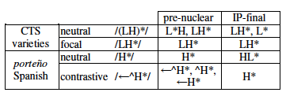
INTONATIONAL STUDIES
Gabriel (2006)
Methodology: answering to questions, reading given sentences and spontaneous speech
Subjects:
17 speakers of Close-to-Standard (CTS) varieties
1 speaker of porteño Spanish
Results: differences in pitch accents:
CTS dialects: LH* in pre-nuclear position/LH* or L* in final position
Porteño Spanish: H* in pre-nuclear position/ HL* in final position

Slide 9
INTONATIONAL STUDIES
Vanrell and Fernández-Soriano (2013):
Production test: question and answer pairs from short picture stories:
Items were controlled for embeddedness and focused constituent: S V O1 O2/Adjunct
Subjects: speakers from different dialects (1 or 2 speakers/dialect)
Results for Castilian Spanish:
More frequent option/ Second more frequent option:
Informational focus
Contrastive focus

Slide 10
MORE EVIDENCE
Against Zubizarreta’s proposal:
Muntendam (2009):
Study of transfer from Quechua into the Spanish of bilingual speakers of the semantics and pragmatics of focus.
SVO order with neutral focus on the subject was produced by the control group
Hoot (2012):
Study of the acceptance of different structures based on the information structure by heritage speakers
Both monolingual (Mexican Spanish) and heritage speakers accept stress shift
Evidence in favor:
Feldhausen and Vanrell (2014):
4 speakers from Madrid used mainly p-movement and clefting for the expression of informational focus

Slide 11
CONCLUSIONS FROM THE PREVIOUS LITERATURE
Most dialects (with the exception of porteño Spanish) use rising pitch accents in the focused word in pre-nuclear position and falling pitch accents in nuclear position (Gabriel, 2006; Vanrell and Fernández-Soriano, 2013).
There is variation on the type of syntactic structures used to encode informational focus across dialects and even individuals: Vanrell and Fernández-Soriano (2013) vs. Fedlhausen and Vanrell (2014)
Other strategies:
Deaccentuation of defocalized elements (Dominguez, 2004; Gabriel 2010 inter alia)
H- at the end of the constituent conveying old information (Hualde, 2002, 2005)

Slide 12
PRESENT STUDY

Slide 13
OBJECTIVES
What is the interaction between prosody and syntax in the expression of informational focus in Asturian Spanish? Does it follow the same trend reported for Castilian Spanish?
Can we find intonational marking of focused constituents? and if so, which intonational strategies are used?
Can we find intonational differences based on syntactic structure?
Analysis of the three most common syntactic structures found in Castilian Spanish:
P-movement
Focus in situ
Clefting

Slide 14
WHY ASTURIAN SPANISH?
Expression of informational focus not studied in this dialect.
In contact with another Romance language, Asturian (approx. 100.000 speakers)
Influence of Asturian in Asturian Spanish (González Quevedo, 2001):
Prosody: use of falling contours in information seeking yes-no questions in Cantabrian Spanish (López-Bobo and Cuevas-Alonso, 2010)

Slide 15
HYPOTHESES
Considering that
There are no studies regarding the realization of informational focus in Asturian
Except for porteño Spanish, dialects of Spanish seem to conform to a general trend (Gabriel, 2006, 2010)
Hypotheses:
Rising pitch accents will be found in pre-nuclear position
When focus is marked in situ: L+H*
When the focus is in a cleft sentence: L+H* H-
Falling pitch accents will be found in nuclear position:
When P-movement has taken place: H+L*
Use of other strategies: H- (Hualde, 2002, 2005)
Following Vanrell and Fernández-Soriano (2013)

Slide 16
METHODOLOGY
Sentence completion task preceded by a short text setting the context: elicitation of more natural full sentences?
Items:
Sentences also contained an indirect object or an adjunct to avoid having the focused object in final position when a neutral word order was elicited
Focused words were always paroxytones
29 per speaker
INFORMATIONAL FOCUS | Subject | Object
P-movement | 3 | 3
Focus in situ | 3 | 3
Clefting | 3 | 3
CONTRASTIVE FOCUS | Subject | Object
Focus in situ | 2 | 2
Clefting | 2 | 2
BROAD FOCUS | 3

Slide 17
Examples
P-MOVEMENT
Tu jefe te comenta que alguien pasó la noche en la oficina. No puedes ayudarle porque no sabes quién fue pero después, tu compañero te comenta que fue Andrea así que vuelves a la oficina del jefe y le dices:
Pasó la noche en la oficina…
FOCUS IN SITU
Tu tío te comenta que alguien escuchó la noticia en la radio. No sabéis quién fue pero unas horas más tarde, alguien te cuenta que fue Andoni así que cuando ves a tu tío, le dices:
Andoni…

Slide 18
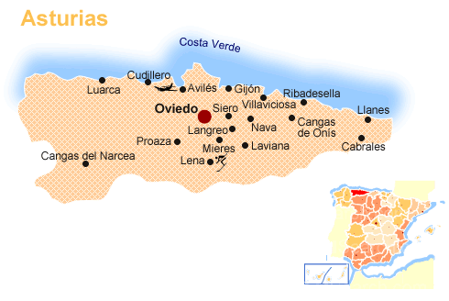
PARTICIPANTS
5 speakers born and raised in Asturias
Ages ranging 19-40 (M= 34.5)
Native speakers of Spanish
4/5 state that they mix Asturian and Spanish when they talk to friends and/or family (exception: speaker 1)
4 from the capital, Oviedo
1 from Grao, a small town, 23 km. from Oviedo
(speaker 5)

Slide 19
ANALYSIS
Some of the items had to be discarded (12 items):
Use of a different syntactic structure:
Pseudo-clefts instead of focus in situ
Interrogative contour
Hesitation
Remaining: 133
Analyzed using Praat (Boersma and Weenink, 2005)
Transcription using the latest Sp-ToBI version (Hualde and Prieto, 2014)

Slide 20
RESULTS

Slide 21
FOCUS IN SITU
Delayed peak (L+<H*) or delayed peak followed by H-
Speaker 3: L+H* !H- (Nibert, 2000: L- after word in narrow focus)
Are they really using intonation to mark focus?

Slide 22
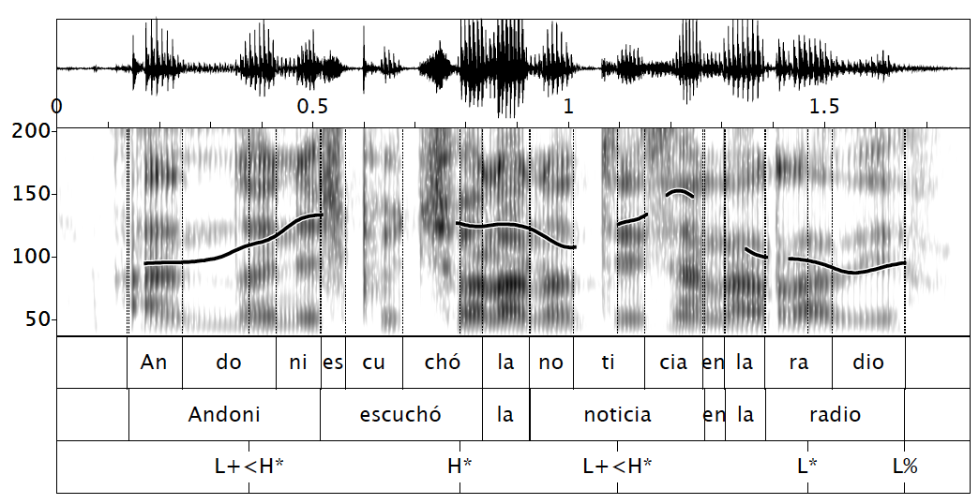
Focus in situ: subject L+<H*
Speaker 1

Slide 23
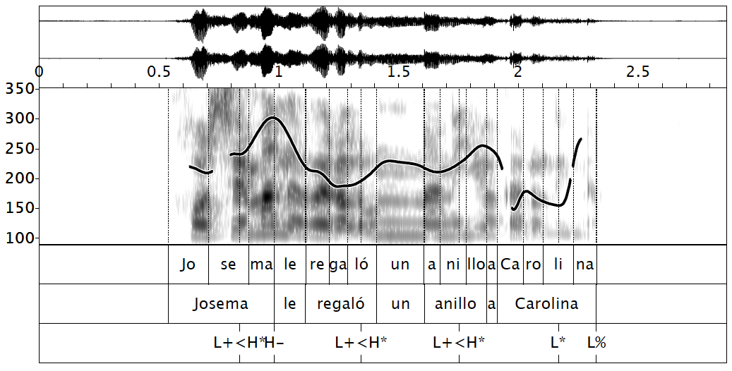
Focus in situ: subject L+<H* H-
Speaker 4

Slide 24
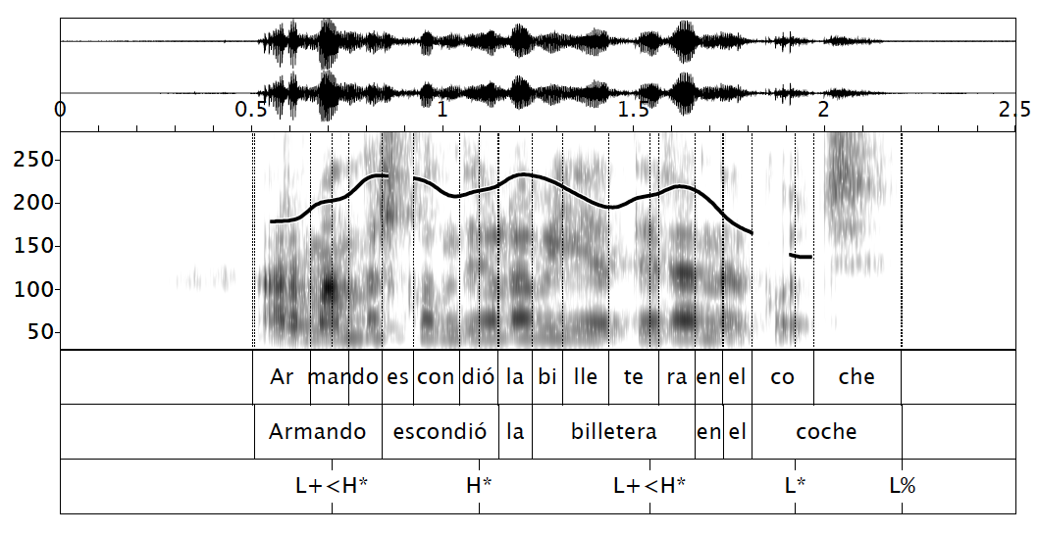
Focus in situ: object L+<H*
Speaker 4

Slide 25
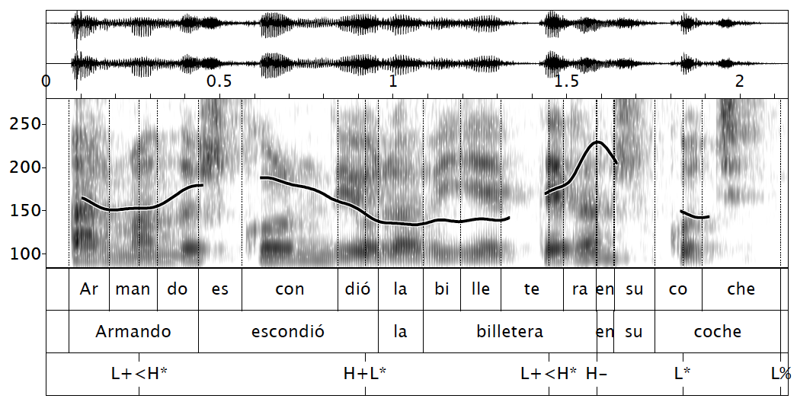
Focus in situ: object L+<H* H-
Speaker 2

Slide 26
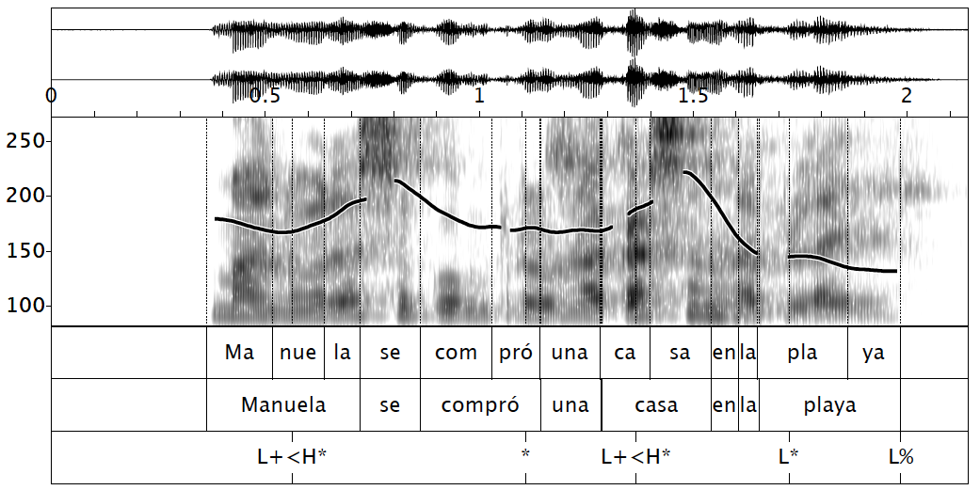
Broad focus
Speaker 2

Slide 27
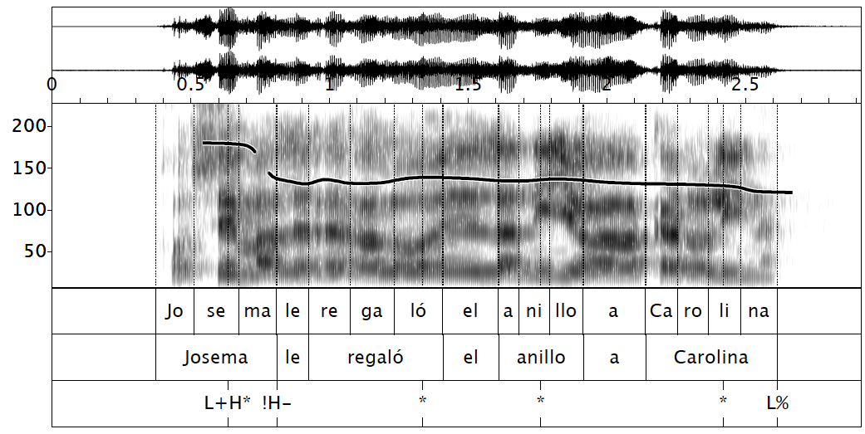
Focus in situ: subject L+H* !H-
Speaker 3

Slide 28
CONTRASTIVE FOCUS-in situ
Individual variation
Speaker 3 and 4 used !H- once
The objects were produced in final position
44% of the cases, preceded by H-

Slide 29
CLEFTING
L+<H* H- is the intonational contour associated with the focused constituent in the cleft
Some individual variation regarding the intermediate boundary tones
Speaker 3 used !H- 4/6
Speaker 5 used LH- 3/6 times

Slide 30
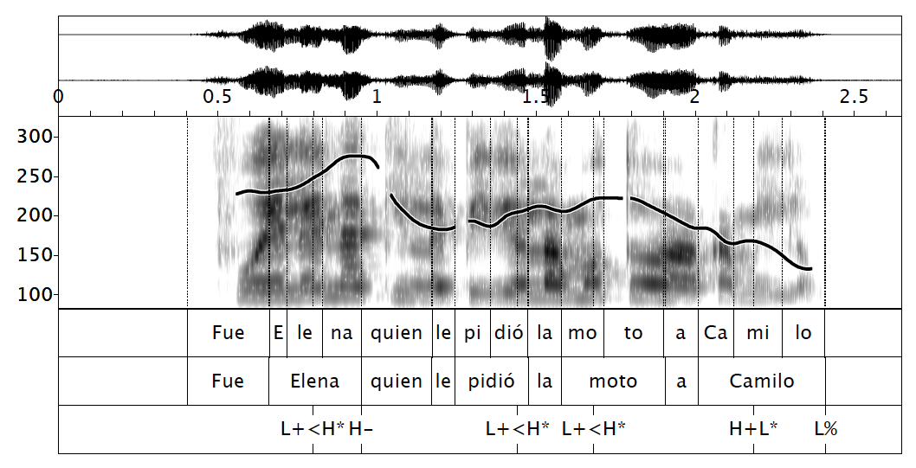
Clefting: subject L+<H* H-
Speaker 4

Slide 31
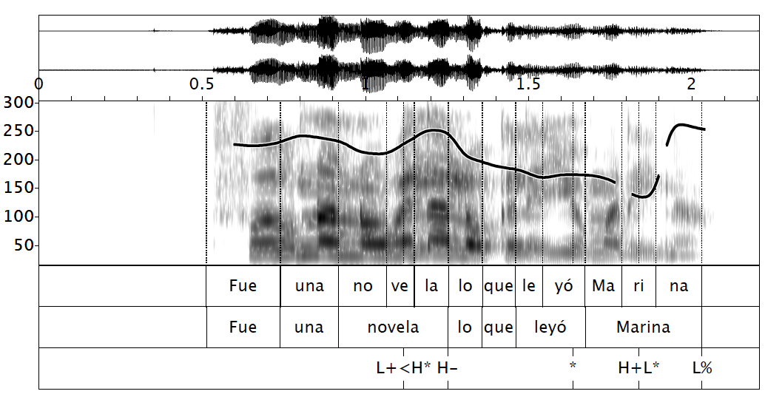
Clefting: object L+<H* H-
Speaker 4

Slide 32
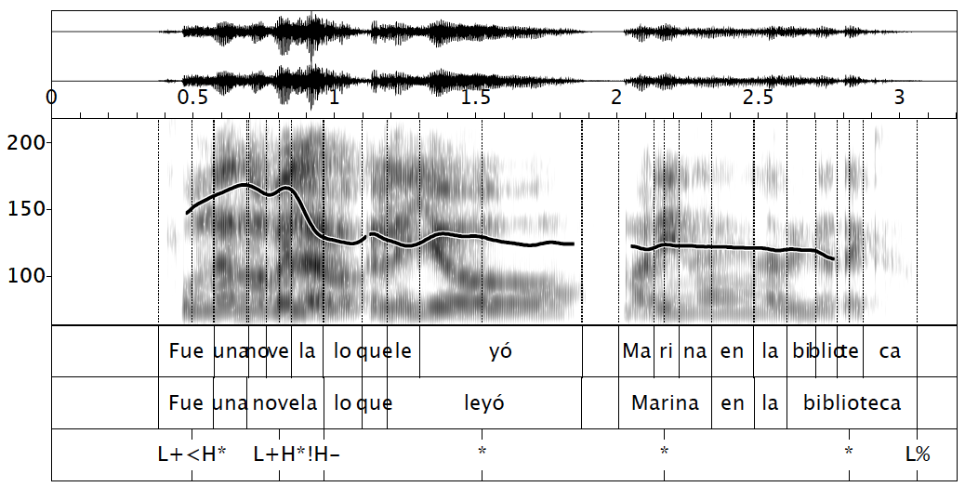
Clefting: object L+H* !H-
Speaker 3

Slide 33
CONTRASTIVE FOCUS-clefting
Same contour used in neutral focus: use of H-
Use of !H-
Speaker 3, 75%
speaker 4, 50%

Slide 34
P-MOVEMENT
The end of the constituent conveying old information was marked with H-
The focused constituent was marked with both
A falling/low pitch accent (subject:73%; object: 70%)
A rising pitch accent

Slide 35
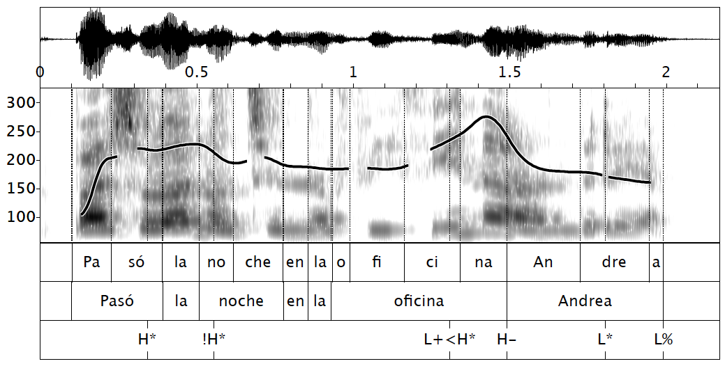
P-movement: subject L+<H* H- L* L%
Speaker 5

Slide 36
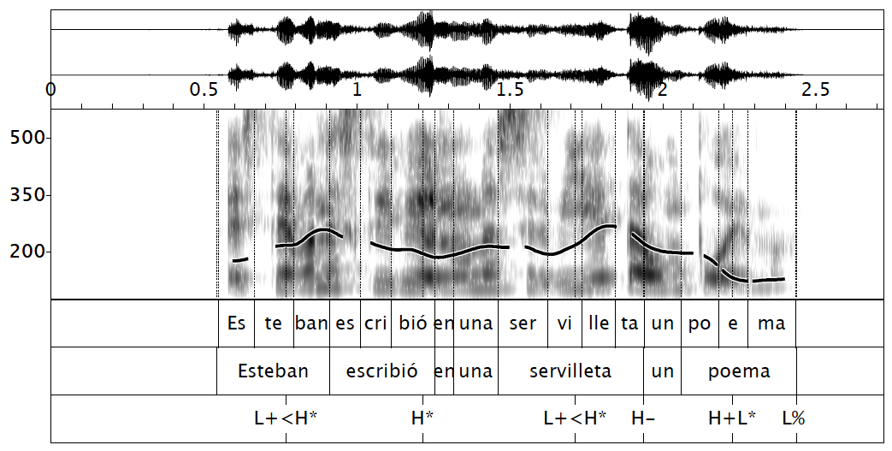
P-movement: object L+<H* H- H+L* L%
Speaker 4

Slide 37
DISCUSSION
Rising pitch accents will be found in pre-nuclear position
When focus is marked in situ: L+H*
Delayed peaks with or without H-
Are they marking focus through intonation?
When the focus is in a cleft sentence: L+H* H-
L+(<)H* H- but also L+H* !H- (speaker 3)
Falling pitch accents will be found in nuclear position:
When P-movement has taken place: H+L*
Use of other strategies: H- (Hualde, 2002, 2005)

Slide 38
DISCUSSION
Variation across speakers
Speaker 3
Is the elicitation task appropriate?
More natural elicitation of full sentences
BUT
Some of the contours may be a result of a reading effect
P-movement with an additional constituent may not be as natural
It does not say much about speaker preferences in terms of the syntactic structure

Slide 39
FUTURE STUDIES
More speakers/more items to confirm the trends
Speakers from other areas of Asturias where the influence from Asturian is bigger
Further analysis of other aspects such as:
Peak height
Peak alignment and duration of the rise (Face, 2001)
Syllable duration (Face, 2001)
Deaccentuation or compression (Labastía, Gabriel et al., 2010)

Slide 40
CONCLUSIONS
Intonational strategies in neutral focus marking:
Asturian Spanish = Castilian Spanish
It is unclear if focus marking in-situ is possible and how it works
L+<H* = L+H*: Support for an underlying (L+H)*(Hualde, 2002)
Use of other strategies such as H-
other acoustic features?

Slide 41
BIBLIOGRAPHY
Bolinger, D. L. (1954). English prosodic stress and Spanish sentence order. Hispania, 152-156.
Contreras, H. (1980). Sentential stress, word order, and the notion of subject in Spanish. The Melody of Language: Intonation and Prosody. 45-53.
Boersma, P. and Weenink, D., Praat (2005). Doing phonetics by computer [Computer program], Version 5.3.62. Retrieved from http://www.praat.org/
Domínguez, L. (2004). The effects of phonological cues on the syntax of focus constructions in Spanish. AMSTERDAM STUDIES IN THE THEORY AND HISTORY OF LINGUISTIC SCIENCE SERIES 4, 256, 69-82.
Face, T. (2001). Focus and early peak alignment in Spanish intonation. Probus,13(2), 223-246.
Face, T. L., & D'Imperio, M. (2005). Reconsidering a focal typology: Evidence from Spanish and Italian. Italian Journal of Linguistics, 17(2), 271-289.
Gabriel, C. (2006, May). Focal pitch accents and subject positions in Spanish: Comparing close-to-standard varieties and Argentinean Porteño. In Speech prosody.
Gabriel, C. (2010). On focus, prosody, and word order in Argentinean Spanish: A Minimalist OT account. Revista Virtual de Estudos da Linguagem, 4, 183-222.
Gonzalez-Quevedo, R. (2001). The Asturian speech community. MULTILINGUAL MATTERS, 165-182.
Gutiérrez-Bravo, R. (2002). Focus, word order variation and intonation in Spanish and English: An OT account. AMSTERDAM STUDIES IN THE THEORY AND HISTORY OF LINGUISTIC SCIENCE SERIES 4, 39-54.
Hoot, B. (2012). Presentational focus in heritage and monolingual Spanish(Doctoral dissertation, University of Illinois–Urbana-Champaign).
Hualde, J. I. (January 01, 2002). Intonation in Spanish and the other Ibero-Romance Languages: Overview and status quaestionis. Amsterdam Studies in the Theory and History of Linguistic Science. Series Iv, Current Issues in Linguistic Theory, 217, 101-116.
Hualde, J. I. (2005). The sounds of Spanish. New York: Cambridge University Press.
Hualde, J.I. & P. Prieto. To appear in 2014. Intonational variation in Spanish: European and American varieties. In S. Frota & P. Prieto (eds.), Intonational variation in Romance. Oxford: Oxford University Press.
López-Bobo, M. J., & Cuevas-Alonso, M. (2010). Cantabrian Spanish intonation. Transcription of intonation of the Spanish language, 49-85.
Muntendam, A. G. (2010). Linguistic Transfer in Andean Spanish: Syntax or Pragmatics? (Doctoral dissertation, University of Illinois at Urbana-Champaign).
Nibert, H. (1999). A perception study of intermediate phrasing in Spanish intonation. Advances in Hispanic linguistics, 231-247.
Ortega-Llebaria, M. and L. Colantoni (2014). L2 ENGLISH INTONATION . Studies in Second Language Acquisition, 36, pp 331-353. doi:10.1017/S0272263114000011.
Samek-Lodovici, V. (2003). The internal structure of arguments and its role in complex predicate formation. Natural Language & Linguistic Theory, 21(4), 835-881.
Vanrell Bosch, M. D. M., & Soriano, O. F. (2013). Variation at the Interfaces in Ibero-Romance. Catalan and Spanish Prosody and Word Order. Catalan Journal of Linguistics, 12, 1-30.
Vallduví, E. (1993). The informational component. IRCS Technical Reports Series, 188.
Vallduví, E., & Engdahl, E. (1996). The linguistic realization of information packaging. Linguistics, 34(3), 459-520.
Zubizarreta, M. L. (1998). Prosody, focus, and word order (Vol. 213). Cambridge, MA: MIT Press.

Slide 42
¡MUCHAS GRACIAS!

Slide 43
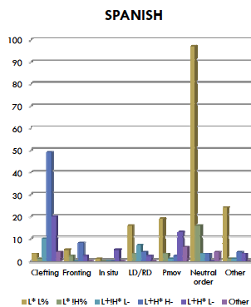
INTONATIONAL STUDIES
Vanrell and Fernández-Soriano (2012):
Methodology:
Production test: question and answer pairs from short picture stories
Spanish data: 10 speakers from Madrid
Most common strategies for informational focus:
Neutral word order: falling contour
= Broad Focus
Clefting: L+H* H-
= Contrastive Focus
No effect of embeddedness or length of the constituent

