Slide 1
Using prosody and intonation to identify accents: The role of peak and valley alignment in the Spanish of Córdoba, Argentina
Jennifer Lang-Rigal
James Madison University
InToSpan I, University of Massachusetts Amherst
Oct.2014

Slide 2
Outline
Intonation of Córdoba Spanish
Research questions
Methodology 1: Production
  Acoustic analysis of tokens
  Results : Peak alignment
Methodology 2: Perception
  Positive and negative Córdoba identification
  Results : mis-identified tokens
Discussion of perception and peak alignment

Slide 3
Intonation of Córdoba Spanish
The tonada cordobesa: the regional variety of Spanish spoken in Córdoba, Argentina
lengthened pre-tonic vowel (i.e. /to:ná.da/)
phrase final position
accompanied by a rise in pitch which is anchored to the pre-tonic syllable
(Fontanella de Weinberg 1971; Yorio 1973)

Slide 4

[e:xemploh]
Asique, por eso también, media que se complica
viste, no emití opinión ni nada porque. Porque esa opinión, pequeña, que yo a emitir, va a pasar como teléfono descompuesto. Puede hacer otro círculo, y… entonces me quedé en el molde.
No. ahora estoy acá desde el año pasado.

Slide 5
Previous Impressionistic descriptive studies - Fontanella de Weinberg (1971)
lengthening is accompanied by a tonal ascent or descent on the second half of that vowel and even in cases where the tonal height did not change, there was still tonal contrast of the lengthened vowel
the pre-tonic and tonic syllables and any post-tonic syllables the combined center of not just the lexical pitch contour but the principal pitch movement of the intonational phrase

Slide 6
Previous descriptive studies – Yorio (1973), Malmberg (1950)
Pre-tonic vowel lengthening is nearly obligatory in spontaneous speech, less frequent in read speech (Yorio 1973)
The tonada cordobesa displays a “stress-shift” (Malmberg)

Slide 7
Empirical Pilot studies in vowel lengthening
Lang (2010) – tonic vowel had a significantly higher mean pitch (F0) when compared to the pre-tonic pitch in a t-test in phrase-finally placed words of declarative utterances taken from naturally produced recordings (p<.01)
Lang-Rigal (2012) - pre-tonic vowel lengthening and the alignment of the peak in the tonic syllable

Slide 8
Research Questions
Does peak alignment play a part in the tonada cordobesa? How does the peak align relative to the tonic and pre-tonic syllables? Does this differ from other varieties of Argentine Spanish (i.e. Buenos Aires and Tucumán)?
In a dialect identification task, which tokens are perceived as sounding more or less Cordoban, and how does this correlate to their acoustical characteristics?

Slide 9
Methodology I: Acoustic Analysis of La tonada cordobesa

Slide 10
Speakers
Spontaneous, natural speech from sociolinguistic interviews
Córdoba capital – lifetime residents
Control groups: Buenos Aires and Tucumán natives
Monolingual Spanish
Speaker origin | sex
CORDOBA | Male | Female
Younger (19-32) | 2 | 2
Middle-aged (33-47) | 2 | 2
Older(48-64) | 2 | 2
(Total CO) |  | 12
BUENOS AIRES | 2 | 2
TUCUMAN | 2 | 2
(Total BA, TU) |  | 8
Total all speakers |  | 20

Slide 11
Tokens
Basic selection criteria
examples
4-9 syll incl. 1 target word
Target word in nuclear position
Declarative intonation
2 tokens each speaker = 40 tokens
Avoid: regional names, words, or phonetic markers (/r/,/ʒ/)
dentro de la arGENtina
más se puede penSAR,
Así en la coCIna.
en la secunDAria.
le fui a visiTAR.
tenes que aprenDERlo.
O sea, el priMEro.

Slide 12
Measurements
Pitch (following Colantoni 2011)
time and ERB at:
  point 1 at the onset of the tonic syllable
  point 2 at the valley, or lowest point of the pitch before rising
  point 3 at the peak, or the highest point before leveling off and/or dropping

Slide 13
Results: pitch movement
The 3 points sometimes occurred in that order sequentially (1 onset, 2 valley, 3 peak)
although for many Córdoba and Tucumán tokens the valley began before the onset of the stressed syllable.

Slide 14
Nuclear pitch curves for Dialect Identification tokens
Notes:
The Tucumán tokens were the most consistent, with 7/8 tokens reaching the peak in the tonic syllable. In the eighth case the peak was post-tonic. The other two dialect groups showed more diversity. Córdoba speakers reached the peak in the pre-tonic syllable in 5/23 tokens, the tonic in 13/23 tokens, and the post-tonic in the remaining 5/23 tokens. Buenos Aires tokens, though much fewer, showed a similar mixed distribution: 1 pre-tonic peak, 2 tonic, and 2 post-tonic

Slide 15
Results
Córdoba tokens show the earliest valley and earliest peaks. The slope duration is about the same as that from Buenos Aires tokens, but these tonal events occur earlier.
Buenos Aires token slope fits the descriptions made by previous linguists (Kaisse 2001; Colantoni & Gurlekian 2004): valley and peak are close together (likely within the same syllable), the rise is fast and peak alignment is early compared to standard Spanish for declarative neutral utterances (Hualde 2005).
Tucumán: results are not surprising. This dialect has been described as having lengthened tonic syllables (Rojas 2000), which would allow time for the peak to be reached within this syllable.

Slide 16
Methodology 2: Positive and negative Córdoba identification

Slide 17
Perception test set-up
Matched-Guise format
2 token types:
  Natural (n=40)
  manipulated (n=40)
Pre-tonic vowel Duration manipulation (Praat)
  50% shorter for CO speakers
  100% longer for BA,TU speakers

Slide 18
Matched-guise Dialect identification
Córdoba speaker
Natural token
Pre-tonic V = 120ms
“Así en la cooocina”
Córdoba speaker
Manipulated token
Pre-tonic V = 60ms
“Así en la cocina”

Slide 19
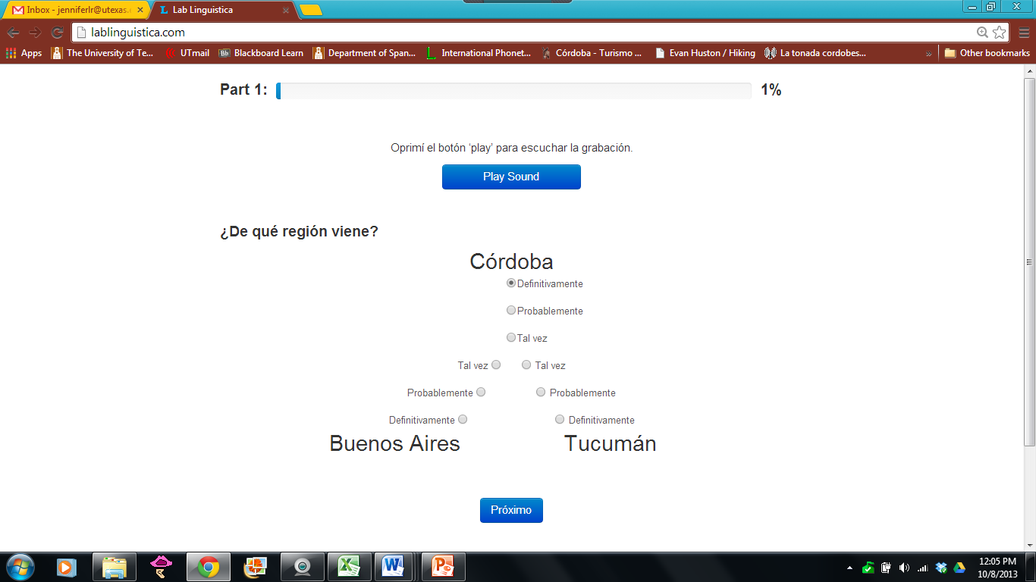
Methodology - procedure
Dialect Identification Task
-online format
-perception only
-forced choice: between 3 regions with 3 degrees of certainty
-80 tokens total: (~10 min to complete)

Slide 20
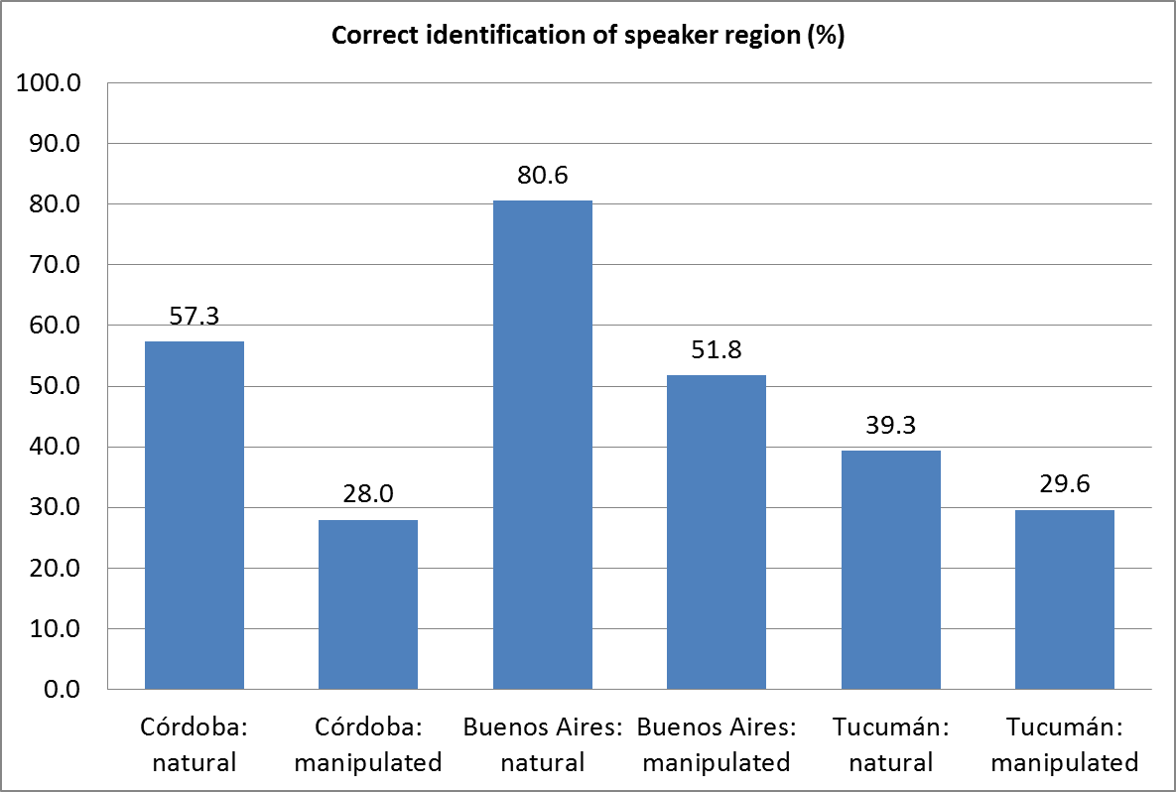
Results: dialect identification

Slide 21
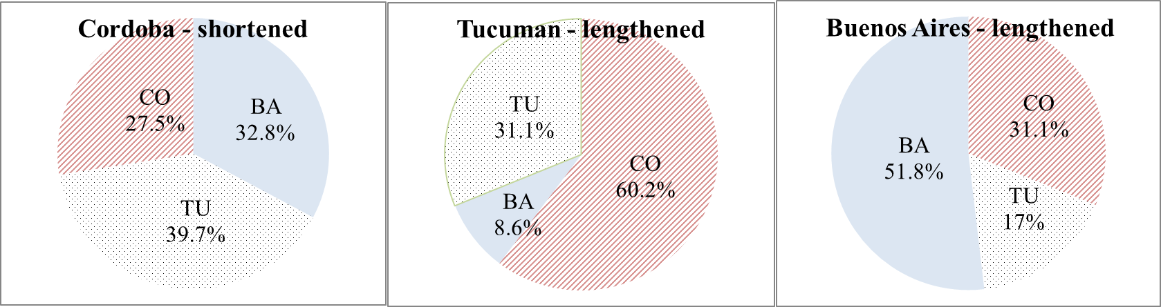
Dialect identification for manipulated (pre-tonic vowel duration) tokens

Slide 22
Perception of Córdoba speakers
Correct ID
Mis-ID
Speaker is identified as CO for natural token
Speaker is identified as TU or BA for manipulated token
Speaker is identified as BA or TU for natural token
  Negative Identification
  11 tokens from 6 speakers
Speaker is identified as CO for manipulated token
  Positive Identification
  2 tokens from 1 speaker

Slide 23
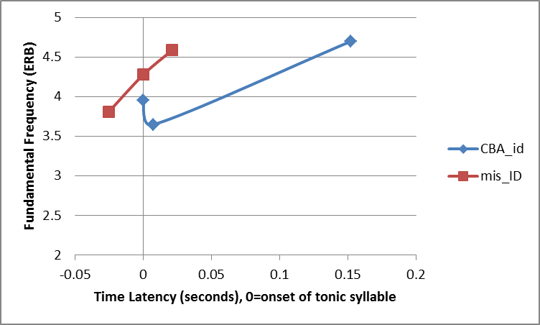
Perception and acoustic characteristics

Slide 24
Results
the peak is reached much earlier in the misidentified speakers.
the duration of the rise from valley to peak is only 46.5ms for these tokens, which is much faster than any other slope measured.

Slide 25
Discussion
This unusually fast slope of mis-id Córdoba tokens may account for these tokens being misidentified, as such a contour would likely be difficult to perceive and so provide less acoustic information for the listener to determine the speaker’s dialect.
It´s possible the intonational contour is in fact as important a cue for dialect identity as pre-tonic vowel duration has proven to be.

Slide 26
Discussion
(Colantoni 2011) found that both Buenos Aires and Córdoba intonation curves showed faster rises to low peaks, which fell more steeply than the other dialects studied (Northeastern and Western Argentine varieties) in nuclear position for declarative utterances.
Specifically, the Buenos Aires speakers showed early peak alignment but not early valley alignment, similar to the results reported in the present study. Both the valley and peak occurred within the tonic syllable

Slide 27
Conclusions
Peak alignment seems to differentiate these three dialects (in addition to differing ratios of duration for pre-pre-tonic, pre-tonic, tonic and post-tonic syllables)
No empirical evidence for a “stress-shift” in Córdoba Spanish (Malmberg 1950)
No empirical for the lengthening to be accompanied by a tonal ascent or descent (Fontanella de Weinberg 1971)
Stress seems to be realized on the tonic syllable for the tonada cordobesa, as indicated by pitch increase

Slide 28
Future directions
More tokens, more controlled (but at least semi-spontaneous) for further tonal analysis
Other suprasegmental analyses: syllable timing and rhythm
Matched-guise with duration + pitch manipulation = which is more important in perceiving this dialect? And in perceiving stress?

Slide 29
Acknowledgments
Ludovic Rigal – web development: lablinguistica.com
Laura Colantoni
Almeida Jacqueline Toribio
Los participantes cordooobeses, tucumaaanos y porteñooos

Slide 30
Works cited
Colantoni, L. (2011) Broad-focus declaratives in Argentine Spanish contact and non-contact varieties. In: Gabriel, Christoph and Conxita Lleó (eds.), Intonational Phrasing in Romance and Germanic: Cross-linguistic and bilingual studies. viii, 237 pp. (pp. 183–212)
Colantoni, L., & Gurlekian, J. (2004, August). Convergence and Intonation: Historical Evidence from Buenos Aires Spanish. Bilingualism: Language and Cognition, 7(2), 107-119.
Fontanella de Weinberg, M. B. (1971). La entonación del español de Córdoba (Argentina) Thesaurus: Boletín del Instituto Caro y Cuervo. 26(1),11-21
Hualde, J.I. (2005). The Sounds of Spanish. Cambridge University Press: Cambridge, UK; New York.
Kaisse, E. (2001). The Long Fall: An Intonational Melody of Argentinian Spanish. In Features and Interfaces in Romance, J. Herschensohn, Mallen, E. & Zagona, K., (147-160) Amsterdam: John Benjamins.
Lang, J. (2010, November). Prosody in Córdoba, Argentina: a sociolinguistic analysis of the tonada cordobesa. Paper presented at the annual meeting of New Ways of Analyzing Variation, San Antonio, TX.
Lang-Rigal, J. (2012). Pre-tonic vowel lengthening in the Spanish of Córdoba, Argentina. Unpublished Manuscript.
Rojas, E. M. 2000. El español en el noroeste. In Español de la Argentina y sus variedades regionales. (eds.) M.B. Fontanella de Weinberg ; Donni de Mirande, N.E. ; Abadía de Quant,I. ; Rojas, E.M. ; Viramonte de Ávalos, M. ; Cubo de Severino, L. El español de la Argentina y sus variedades regionales. Edicial: Buenos Aires, Argentina.
Yorio, C. Al. “Phonological style in the dialect of Spanish of Córdoba, Argentina.” Dissertation: University of Michigan (1973).

Slide 31
Pre-tonic vowel duration
Pretonic Vowel | Córdoba | Buenos Aires | Tucumán | All tokens
Min Nat. Dur (ms) | 35 | 47 | 59 | 35
Max Nat. Dur (ms) | 194 | 75 | 102 | 194
Avg Nat. Dur (ms) | 109 | 59 | 72 | 91

Slide 32
Negatively identified tokens of Cordoba speakers
token | speaker | transcription | target | Syll | %correct | PP /Pre | T/Pre | T/Post
id_13 | YUF1 | le fui a visitar. | visitar | 6 | 22.2 | 0.531 | 1.257 | .
id_15 | YUF2 | tres semanas, no más | semanas | 6 | 26.9 | . | 0.917 | 1.006
id_17 | AUF1 | dentro de la Argentina. | Argentina | 8 | 39.7 | 0.393 | 0.514 | 0.914
id_19 | AUF2 | pero no lo sé traducir… | traducir | 8 | 39.7 | 1.566 | 2.318 | .
id_21 | AUM1 | en la secundaria. | secundaria | 7 | 14.3 | 0.604 | 0.818 | 1.805
id_23 | AUM2 | Escuchar…tres. | escuchar | 7 | 30.1 | 0.380 | 1.209 | .
id_25 | AWF1 | me costó mas, eh, | costó | 5 | 15.9 | . | 0.226 | .
id_33 | OWM1 | Somos humanos. | humanos | 5 | 30.1 | . | 1.219 | 0.818
id_35 | OWM2 | O sea, el primero. | primero | 7 | 49.2 | . | 0.487 | 1.418
id_37 | OUM1 | Escuchar, uno… | escuchar | 5 | 19 | 1.139 | 2.504 | .
id_39 | OUM2 | volví de Malvinas… | Malvinas | 6 | 27 | . | 0.695 | 0.451
2/3 of negatively identified CO speakers was grouped as “upper-middle class”

Slide 33
Positively identified tokens from Cordoba speakers (1 speaker)
token | speaker | transcription | target | Syll | %correct | PP/Pre | T/Pre | T/Post
id_05 | YWM1 | Así en la cocina. | cocina | 7 | 96.8 | . | 0.716 | 1.618
id_06 | Manipulated (shortened) |  |  |  | 79.3 | . | 1.019 | 1.618
id_07 | YWM2 | En la secundaria… | secundaria | 7 | 96.8 | 0.510 | 0.889 | 0.951
id_08 | Manipulated (shortened) |  |  |  | 66.7 | 0.748 | 1.304 | 0.951

