Slide 1
Reconsidering Spanish pitch accent distribution: H+L* in Bogotá Spanish 1ST SYMPOSIUM ON INTONATION & TONE IN THE SPANISH-SPEAKING WORLD October 10–11, 2014 (UMass-Amherst)
Alba Arias Álvarez & Meghan E. Armstrong
aariasalvare@spanport.umass.edu
armstrong@spanport.umass.edu

Slide 2
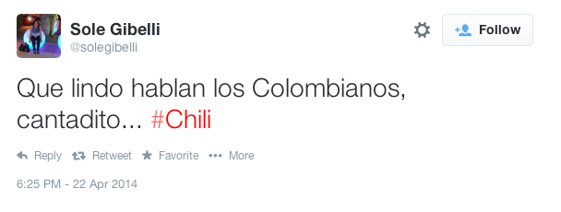
Colombian Spanish

Slide 3
Colombian Spanish

Slide 4
Colombian Spanish
“Cantadito” is a term many Spanish speakers use to describe other varieties of Spanish in general, and so it should be taken with a grain of salt.
But… is there something different about Colombian Spanish intonationally that could be driving this folk perception?
https://www.youtube.com/watch?v=M3jHqBchpUo

Slide 5
Colombian Spanish
What’s going on with Colombian Spanish???

Slide 6
Background
In recent years, researchers have described more and more Spanish dialects within the Autosegmental Framework
Sp_ToBI system continues to be tested by adding more and more dialects of Spanish
Colombian Spanish intonation has been described only recently
Velásquez Upegui (2013) analyzes principal dialect areas of Colombia comparing different types of utterances.

Slide 7
Prenuclear pitch accents in Spanish
It is generally accepted that most varieties of Spanish present some kind of rising accent in prenuclear position (Sosa 1995, Estebas Vilaplana 2006, Face & Prieto 2007, for a three-way distinction):
L+>H* L*+H L+H*
There is an F0 valley that occurs at or at least very near the stressed syllable.

Slide 8
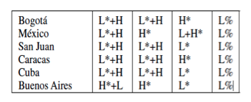
Prenuclear pitch accents in Spanish
Sosa (1999):
Prenuclear and nuclear accents from reading task
Le dieron el número de vuelo
p. 187-197

Slide 9
Prenuclear PAs in Spanish
Until recently, no work that we know of has proposed H+L* as a possible prenuclear pitch accent in Spanish.

Slide 10
Prenuclear pitch accents in Spanish dialects
Velásquez Upegui’s: H+L* in prenuclear position in Colombian Spanish (Bogotá, Cartagena, Cali & Medellín).
Finds this PA in various pragmatic contexts, various utterance types.
Interview, reading task, Discourse Completion Test, map task.
Work focuses on nuclear pitch accents and not prenuclear pitch accents.

Slide 11
Research questions/goals
H+L* not uncommon in nuclear position, but H+L* in prenuclear position? (maybe this is what is driving folk intuitions)
Here we focus on Bogotá Spanish (col. rolo Spanish)
We ask:
Can we confirm the appearance of H+L* in prenuclear position?
Prior work shows that it appears across utterance types, but are there specific utterance types that favor prenuclear H+L* ?

Slide 12
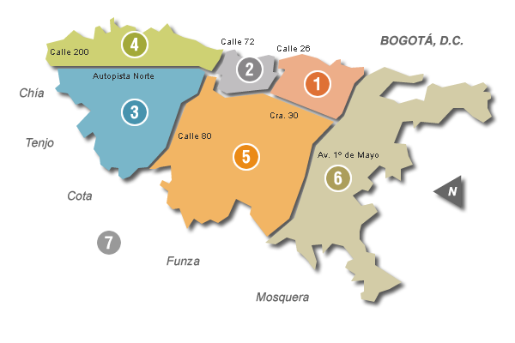
Method: Participants
6 participants
Females
In their twenties
From Bogotá
North: 3 participants
South: 3 participants

Slide 13
Method: Materials
Discourse completion task (Prieto 2001, Prieto & Roseano 2010)
Series of situations and pragmatic contexts to induce the participants to create a certain kind of response.
E.g. Conoce a dos chicas que se llaman Marina, una rubia y otra morena. Diga que hoy vio a la morena.
Hoy vi a Marina, la morena.
Utterance types:
Declaratives
Yes/no questions
Wh- questions
Reiterative interrogatives.
Imperatives
Vocatives
420 target utterances
70/speaker
1388 tokens
231/speaker

Slide 14
Method: Procedures & Analysis
Recordings were made in the participants’ homes and in the lab.
Tokens analyzed with PRAAT.
Data was transcribed using Sp_ToBI (Estebas Vilaplana, E. & Prieto, P., 2009).

Slide 15
Analysis/Results
Mixed effects logistic regression.
Dep. Variable: H+L* presence vs. non-presence
Possible predictors: Position (prenuclear vs. nuclear) and Utterance Type.
Position was selected as a significant predictor –
H+L* found significantly more in prenuclear position vs. nuclear position (p<0.001).
Further, we looked at the effect of Utterance type on prenuclear H+L*s
None of the utterance types were shown to be significant predictors of H+L* presence in prenuclear position.

Slide 16
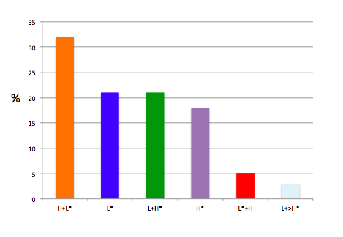
RESULTS Overall pitch accent use
%
H+L* is the most frequently used pitch accent in the corpus.

Slide 17
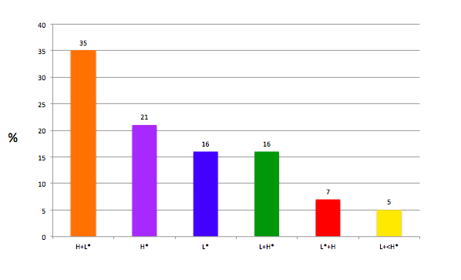
PAs in prenuclear position
%

Slide 18
PAs in prenuclear position
L+>H* and L*+H are the least common PAs in prenuclear position (although they only occur in prenuclear position)!
%

Slide 19
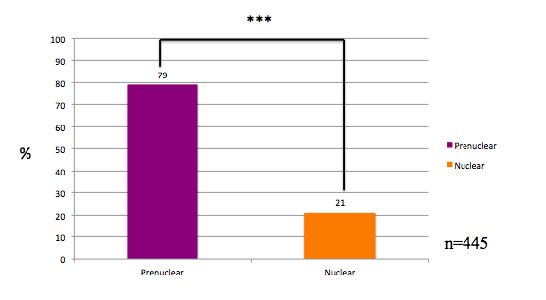
H+L* distribution
H+L* used significantly more in prenuclear position vs. nuclear position. p<0.005

Slide 20
Utterance type
H+L* was found in prenuclear position for all utterance types (except vocatives, but this is because vocatives did not show prenuclear PAs)

Slide 21
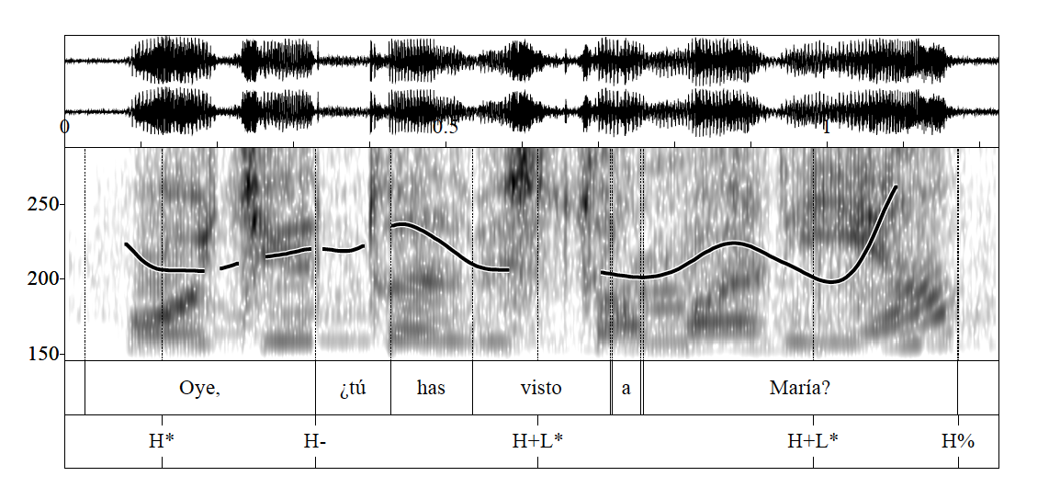
Yes-no question
Oye, ¿tú has visto a María?

Slide 22
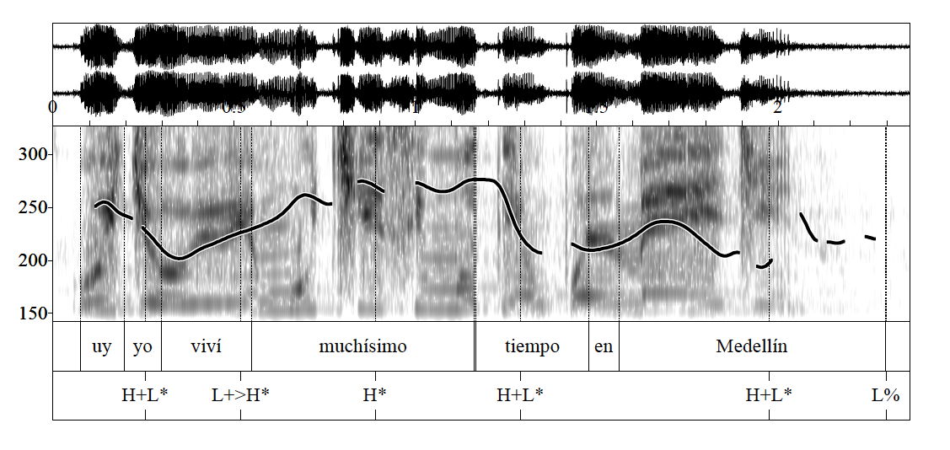
Declarative
Yo viví muchísimo tiempo en Medellín.

Slide 23
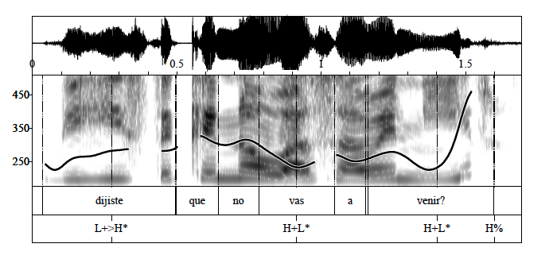
Reiterative
¿Dijiste que no vas a venir?

Slide 24
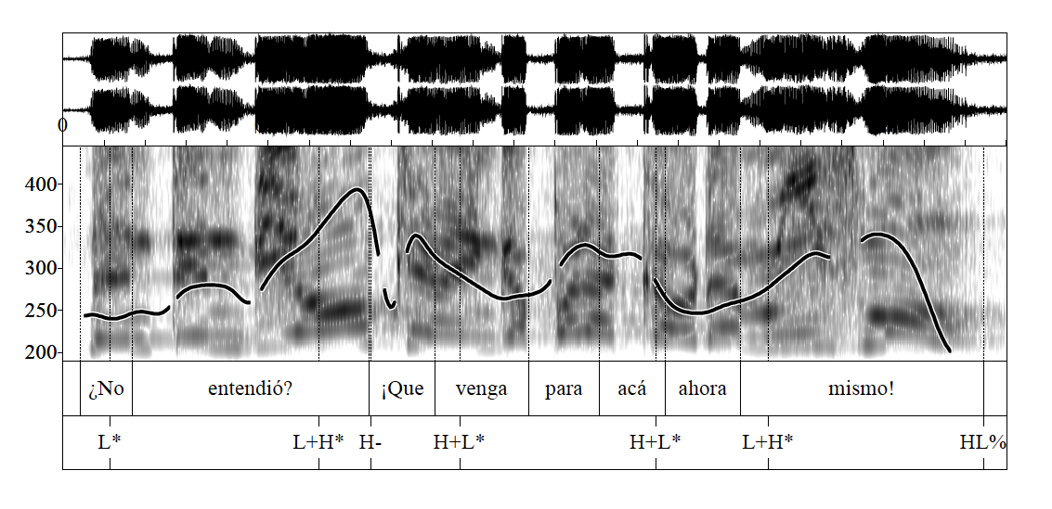
Imperative
¿No entendió? ¡Que venga para acá ahora mismo!

Slide 25
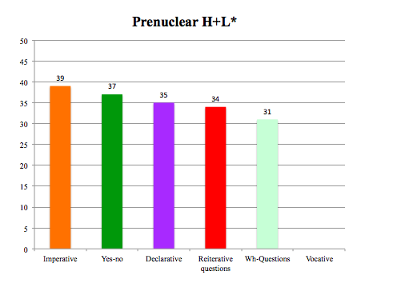
Utterance type

Slide 26
% PA by utterance type

Slide 27
Summary of findings
H+L* is most frequent pitch accent in the corpus
H+L* is most frequent prenuclear pitch accent
H+L* possible in both prenuclear and nuclear position, but more common in prenuclear position
Typically preferred prenuclear PA regardless of utterance type (though it competes with H*)
The two rising pitch accents typically claimed to occur in prenuclear position are the two least frequent PAs in this position

Slide 28
Implications and future work
This variety behaves in quite a different way than other varieties of Spanish described to date.
Caution in describing “Spanish” as predominantly “rising” in prenuclear position.
May provide good test case for what it means to “hablar cantadito” – H+L* is found in most but not all varieties in nuclear position – does its appearance in prenuclear position lead to perceived “singsonginess” by speakers of other dialects?

Slide 29
References
Armstrong, M. E. 2010. Puerto Rican Spanish Intonation. Transcription of intonation of the Spanish language, ed. by Pilar Prieto & Paolo Roseano, 155-189. Munich: Lincom EUROPA.
Díaz Campos, M., Trevis McGory, J. 2002. La entonación en el español de América: Un studio acerca de ocho dialectos hispanoamericanos. In Boletín de Lingüística, 18, pp. 3-26.
Escudero, D., Aguilar, L., Vanrell, M. M., Prieto, P. 2012. Analysis of inter-transcriber consistency in the Cat_ToBI prosodic labeling system. In Speech Communication, 54, 566-582.
Estebas Vilaplana, E. 2006. Word Edge Tones in Spanish Prenuclear Accents. Estudios de Fonética Experimental 15: 11-42.
Estebas Vilaplana, E. 2007. The phonological status of English and Spanish prenuclear F0 peaks. Atlantis: 39-5.
Face, T., Prieto, P. 2007. Rising accents in Castilian Spanish: a revision of Sp-ToBI. Journal of Portuguese Linguistics 6,1 (special issue on Prosody of Iberian Languages, ed. by G. Elordieta and M. Vigário), p. 117-146.
Gussenhoven, C. 2004. The phonology of tone and intonation. Cambridge: Cambridge University Press.
Hualde, J.I. 2003. El modelo métrico y autosegmental. In P. Prieto (ed.), Teorías de la entonación, 155-184. Barcelona: Ariel.
Hualde, J.I., P. Prieto. To appear in 2014. Intonational variation in Spanish: European and American varieties. In S. Frota & P. Prieto (eds.), Intonational variation in Romance. Oxford: Oxford University Press.
Prieto, P. 2001. L’entonació dialectal del català: el cas de les frases interrogatives absolutes». In: Bover, A.; Lloret, M. R.; Vidal-Tibbits, M. (eds.). Actes del Novè Col·loqui de la North American Catalan Society (Barcelona 1998). Biblioteca Abat Oliba, 230. Barcelona: Publicacions de l’Abadia de Montserrat, p. 347-377.
Prieto, P., Roseano, P. 2010. Transcription of intonation of the Spanish Language. München: Lincom Europa.
Sosa, J.M. 1995. Nuclear and pre-nuclear tonal inventories and the phonology of Spanish declarative intonation. In Proceedings of the Thirteenth International Congress of Phonetic Sciences (K. Elenius & R. Branderand, editors), pp. 646-649.
Sosa, J. M. 1999. La entonación del español. Su estructura fónica, variabilidad y dialectología. Madrid: Cátedra.
Toledo, G. 2008. Fonología de la frase entonativa. Estudios filológicos N. 43.
Velásquez Upegui, E. P. 2013. Entonación del español hablado en Colombia. Tesis doctoral. México, D.F.: El Colegio de México.
Willis, E. W. 2010. Dominican Spanish Intonation. Transcription of Intonation of the Spanish Language, ed. by Pilar Prieto and Paolo Roseano, 123-153. Lincom GmbH.

